Slide 1
Factor-Based Portfolio Strategy Using Fama–French Five Factors
DATA 602 – Principles of Data Science
Semester: Fall 2025
Instructor: Dr. Fardina Alam

Slide 2
Introductions
Rayhan Patel
UID: 122087934
Applied ML
Govind Singhal
UID: 117780413
Applied ML
Chaithanya M
UID: 122257672
Applied ML
Notes:
Everyone

Slide 3
Problem Summary
Problem Statement:
  Can factor-based investment strategies outperform a passive market benchmark using realistic evaluation methods?
Context:
  Traditional passive investing (e.g., buy-and-hold S&P 500) is simple but may miss opportunities. Factor models use market drivers like size, value, and momentum to potentially improve returns.
Key Question:
  Does increasing model complexity lead to better risk-adjusted performance?
Approach:
  Compare three strategies over 15+ years of data with walk-forward backtesting.
Notes:
Chay

Slide 4
Fama–French Five Factors
  Market Risk Premium (Mkt-RF): Market return minus risk-free rate. Measures if stocks beat safe investments.
  Small Minus Big (SMB): Small-cap vs large-cap performance. Captures size effect.
  High Minus Low (HML): Value stocks vs growth stocks. The "value premium."
  Robust Minus Weak (RMW): Profitable vs unprofitable companies. Quality factor.
  Conservative Minus Aggressive (CMA): Conservative vs aggressive investors. Investment discipline factor.
  Risk-Free Rate (RF): Return on safe investments (T-bills). Baseline return.
Notes:
Chay

Slide 5
Models & Rationale – Data & Methodology
Data Sources:
Fama-French factors (publicly available) + S&P 500 prices (Yahoo Finance + Wikipedia)
Key Features:
Monthly returns, 5 factors (Mkt-RF, SMB, HML, RMW, CMA), risk-free rate
Evaluation:
Walk-forward backtesting (train on past, test on future)
Evaluation Metrics: Cumulative Returns, Sharpe Ratio, CAGR, Max Drawdown
Why This Approach?:
Prevents 'look-ahead bias'; focuses on real-world applicability.
Notes:
Chay

Slide 6
Models & Rationale – Overview
Models Compared:
SPY Benchmark: Passive buy-and-hold (baseline)
  Chosen to provide a passive market baseline for evaluating whether active strategies add value beyond broad market exposure.
Ordinary Least Squares Regression Fama-French 5-Factor Model
  Chosen as an economically interpretable linear baseline that explains returns through well-established systematic risk factors.
Linear (Logistic Regression) Fama-French 5-Factor Model
  Chosen to model directional return signals while maintaining linear interpretability and robustness.
XGBoost Fama-French 5-Factor Model
  Chosen to capture nonlinear factor interactions and improve asset selection through cross-sectional ranking.
Why These Models?:
Balances theory (factors) with data-driven approaches; tests complexity trade-offs.
Notes:
Chay

Slide 7
Models & Rationale - SPY Benchmark
What it is
SPY tracks the S&P 500, representing the performance of the broad U.S. equity market.
Used as a passive benchmark to evaluate whether active strategies add value.
How it works
Portfolio holds SPY continuously (buy-and-hold).
No factor timing, no predictions, no rebalancing logic.
Notes:
Rayhan

Slide 8
Models & Rationale - Ordinary Least Squares Regression Model
What the model is
Linear regression model explaining asset excess returns using economic risk factors
Based on the Fama–French factor framework
How it works
Regresses asset excess returns on common risk factors
Coefficients measure sensitivity to each factor
Parameters estimated using Ordinary Least Squares (OLS)
Model equation
Excess Return = α + β₁·MKT + β₂·SMB + β₃·HML + β₄·RMW + β₅·CMA + ε
How it is used
Estimated factor exposures are used to understand return drivers
Serves as a linear benchmark model against more complex approaches
Key characteristics
Linear and interpretable
Economically motivated
Assumes stable linear relationships between factors and returns
Notes:
Rayhan

Slide 9
Models & Rationale - Linear (Logistic Regression) Model
What the model is
Linear binary classifier predicting whether an asset’s excess return is positive
Uses the same factor-based features as the OLS model
How it works
Target variable:
  1 if excess return > 0
  0 otherwise
Learns a linear decision boundary in factor space
Outputs a probability, not a return value
Model Equation
P(Y = 1 | X) = 1 / (1 + exp(−(β₀ + βᵀX)))
How it is used
Assets with higher predicted probability are selected for the portfolio
Key Characteristics
Linear and interpretable
Directional (classification-based)
Probability-driven asset selection
Notes:
Rayhan

Slide 10
Models & Rationale - XGBoost Model
What is the model
Nonlinear gradient-boosted decision tree model
Designed for cross-sectional ranking of assets, not direct return prediction
How it works
Inputs: factor-based features
Learns to assign scores so higher-return assets rank above lower-return assets
Trained to optimize relative ordering within each month
Learning objective
Minimize ranking loss + tree complexity penalty
How it is used
Assets are sorted by predicted score each month
Portfolio holds the top-ranked assets
Key characteristics
Nonlinear
Captures factor interactions
Focuses on relative performance
Less interpretable than linear models
Notes:
Rayhan

Slide 11
Models & Rationale – Evaluation Metrics
Cumulative Returns: Total compounded return of the portfolio over the entire period.
Sharpe Ratio: Risk-adjusted return measured as excess return per unit of volatility.
CAGR: Average annual growth rate assuming returns are compounded.
Max DD: Largest peak-to-trough decline in portfolio value over time.
Notes:
Govind

Slide 12
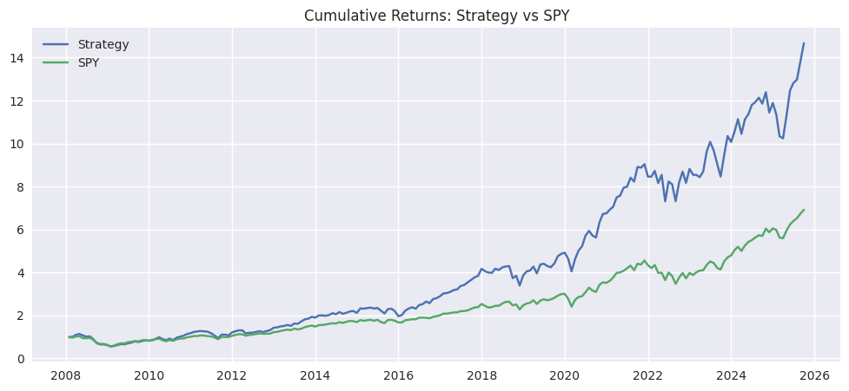
Results Visualization – Performance Overview (OLS)
OLS (Strategy) has significantly more cumulative returns, nearly doubling in a 20 year period
Notes:
Govind

Slide 13
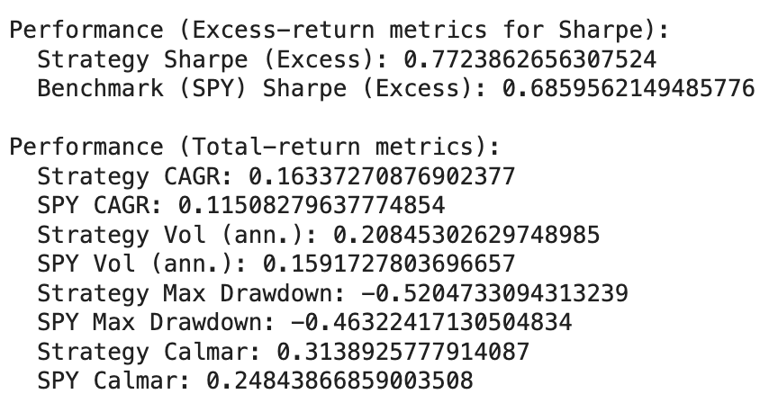
Results Visualization – Risk-Adjusted Metrics
Notes:
Govind

Slide 14
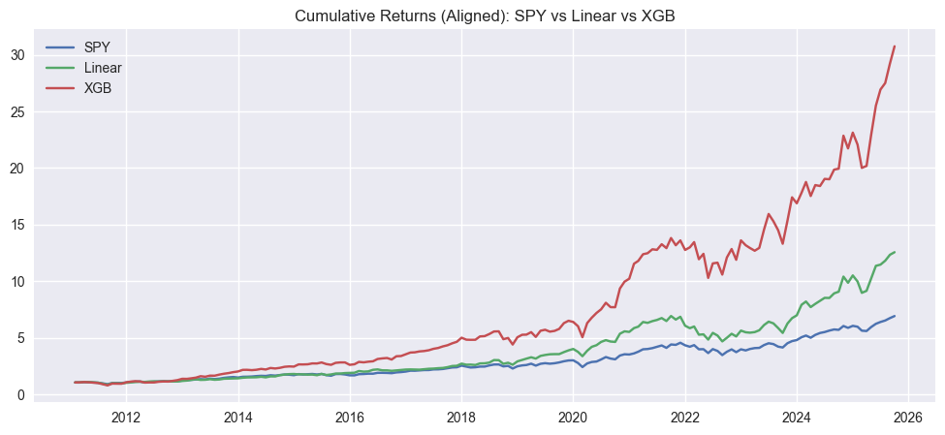
Results Visualization – Performance Overview (ML)
XGBoost: Highest overall cumulative returns
Linear FF5: Stable but lower than XGBoost
SPY: Least Cumulative Returns
Key Insight: XGBoost captures nonlinear patterns for superior long-term growth.
Notes:
Govind

Slide 15
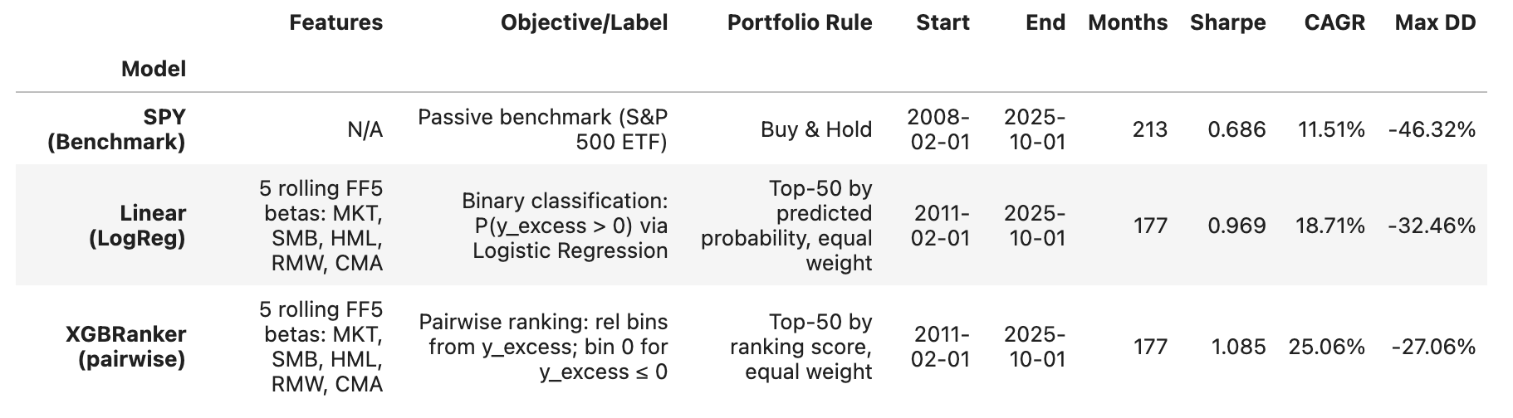
Results Visualization – Risk-Adjusted Metrics
Notes:
Govind

Slide 16
Conclusion & Future Work
Main Takeaways:
Factor-based strategies meaningfully outperform the passive SPY benchmark across the full sample period.
The Linear (FF5) model delivers stable, interpretable outperformance, improving both CAGR and Sharpe ratio relative to SPY.
The XGBoost ranking model achieves the highest cumulative returns and Sharpe ratio, indicating superior ability to exploit nonlinear factor interactions.
Higher returns from ML-based models come with increased volatility, highlighting the importance of risk-adjusted evaluation.
Overall, results suggest that systematic factor modeling (specially with nonlinear methods) can enhance long-term portfolio performance beyond traditional benchmarks.
Future Directions:
Reduce risk: Add simple rules to limit losses during large market downturns.
Add more signals: Try including additional factors or basic momentum indicators.
Understand the model: Look at which factors matter most for the XGBoost model.
Test elsewhere: Apply the strategy to other markets or assets to see if it still works.
Notes:
Govind

Slide 17
Contributions
Rayhan – Co-developed the project idea with the team, aiming for a finance/fintech project that demonstrates end-to-end modeling and is strong for a resume (A). Led the Fama--French 5 Factors data pull/cleaning and ensured factor definitions and dates aligned with the rest of the pipeline (B). Completed key exploratory checks (time-series trends, outliers/boxplots) and produced several figures used in the analysis and results discussion (C, F). Built and evaluated the XGBoost modeling workflow, including feature construction, training/testing logic, and performance reporting, and helped integrate findings into the final write-up (D, E, G).
Govind – Co-developed the project idea with the team as a practical equity-factor/fintech-style study focused on portfolio-ready skills (A). Implemented the S&P 500 universe construction (Wikipedia) and supported merging/clean alignment of the stock universe with factor and returns panels (B). Performed EDA focused on correlation structure and factor–return relationships to motivate modeling choices (C). Implemented the rolling-window Fama--French regression baseline (beta estimation and walk-forward prediction) and contributed comparative result analysis and figures for the report (D, E, F). Co-wrote methodology/results sections and helped polish the final report (G).
Chaithanya – Co-developed the project idea with the team to build a finance/fintech project that highlights data engineering and ML validation skills (A). Constructed the monthly returns dataset using yfinance and ensured consistent resampling and date alignment across prices, returns, and factor series (B). Ran distribution diagnostics and pipeline sanity checks (missing data, ticker/month coverage, and transformation validation) and documented edge cases encountered during integration (C, H). Supported model evaluation by verifying split logic and reproducibility across reruns, and contributed figures/tables plus edits to the final conclusions and formatting (E, F, G).

Slide 18
Thank You!
Any Questions?

